Slide 1
Introduction to User Experience Session #01
Course : GAME6012/ User Experiences
Effective Period : September 2017

Slide 2
These slides have been adapted from: Julie A. Kientz (2014). User Experience Design, University of Washington.
Acknowledgement

Slide 3
Learning Objectives

Slide 4
What is Design?
Creative endeavor
Process of creating or shaping tools or artifacts for direct human use
Outputs are things
people-centered concerns
Processes, methods

Slide 5

Design vs. Engineering
Engineering
Make a mostly-known outcome possible
Construct a sturdy bridge based on specifications
Concerned with what can be done
Reliance on well-established formulae
Humans may or may not be directly “in the loop”
Design
Envision new possibilities, new outcomes
Determine what outcome should result among infinite possibilities
Reliance on process over formulae
Humans are central actors “in the loop”

Slide 6
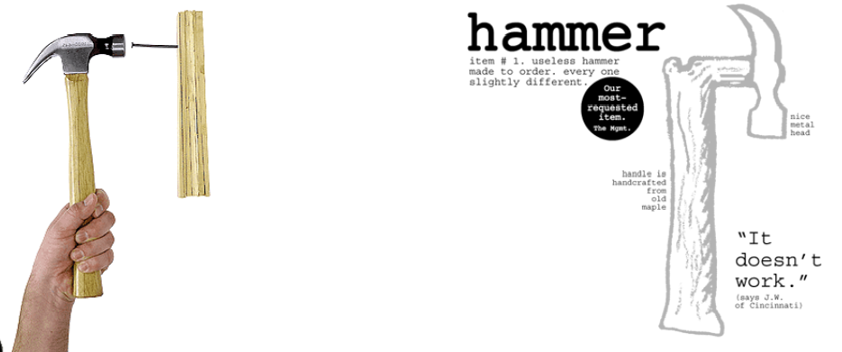
Design vs. Art
Design (as we regard it) concerns the creation of something useful and usable
Art does not bother with this restriction
The test: how to deem what is “good”?

Slide 7
User Experience Definitions
"User experience" encompasses all aspects of the end-user's interaction with the company, its services, and its products.”
“The first requirement for an exemplary user experience is to meet the exact needs of the customer, without fuss or bother. Next comes simplicity and elegance that produce products that are a joy to own, a joy to use. True user experience goes far beyond giving customers what they say they want, or providing checklist features.
-Nielsen-Norman Group

Slide 8

Who Does Design?
Designers!
Interface designers
Interaction designers
Industrial designers
Graphic designers
designers are also often:
Applied anthropologists
Design ethnographers
Social psychologists
Cognitive psychologists
Experimental psychologists
Computer scientists
Engineers
Information architectsa

Slide 9


What is Designed?
“Look around you. The only thing not designed is Nature.”
David Kelley
Anything consciously intended for human use is designed
Often poorly, though, which is where user experience design comes in

Slide 10
What is Designed in UX?
Artifact view: The object, device, or system that is designed
Holistic view: The interaction, the flow, the user's experience are all designed
all potential users (often > 1)
all other stakeholders
manuals
tutorials
help systems
customer support
what else?
Think in terms of users' goals
Artifacts have no goals
People have goals!
Keep users in the center in the beginning, middle, and end

Slide 11
Why is Design Hard?
Experience design is multidisciplinary
Judging/predicting which designs will be successful and which will not is difficult
It is simply hard to come up with good solutions
The space of “the possible” is vast compared to the space of “the good”

Slide 12
Why is Design Hard?
All design involves making tradeoffs
Can't maximize everything
Good designs are non-obvious
Humans are unpredictable
Humans make errors
Design relies on process expertise, not knowledge expertise

Slide 13
Core Skills of Design
To synthesize a solution from all of the relevant constraints, understanding everything that will make a difference to the result
To frame, or reframe, the problem and objective
To create and envision alternatives.
To select from those alternatives, knowing intuitively how to choose the best approach.
To visualize and prototype the intended solution

Slide 14
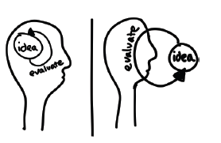
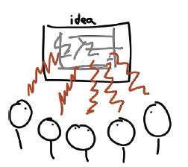
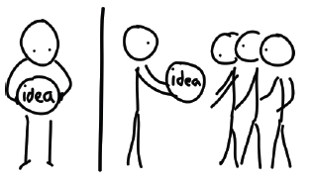
Sketches on Design Thinking (Andy Ko)

Slide 15
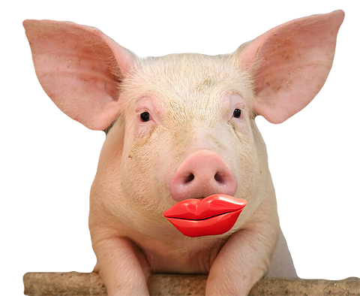
Design is Not Just “Lipstick on a Pig”
Not just changing how things look
Or making things pretty
Or designing graphics

Slide 16
“The user is not like me”
Why not?
Designers are much more familiar with the interface and with the problems being solved than users.
Designers are confident. Users are often fearful.
Designers work in settings that are different than the context in which the product may be used.
Designers may have different skills than users (e.g., perceptual, cognitive, or domain skills).
(from Don Norman)

Slide 17
What is UX?
UX is a skill. It's a practice. It's about where to place a button on a website and how to organize content. It's about how to improve screen and interface design. It's about wireframes, focus groups, and usability studies.
UX is also about collaboration. It's about solving problems and finding solutions. UX is about looking at the world with a unique perspective and a unique mindset. UX is also about focusing on the right people at the right time, including customers, end users and also stakeholders whose business goals and objectives are directly related to UX decisions.

Slide 18

Look at the video
Source: https://www.youtube.com/watch?v=2lXh2n0aPyw

Slide 19
Creating UX for apps, web and game?
Usually developer of non game approaches are:
transparent, so that the user needs to think as little as possible
affordant, so that the user knows what possibilities it offers
scalable, so that it unfolds as the user develops skills
feedback-rich, so that the user knows when they did something
constraining, so that the user can’t do things that get them in trouble
While game developer did:
challenging. Often, we want the game to make the user think a lot.
explorable. We usually want the user to think there are always more possibilities in there.
scalable, so that players learn better play as they play.
crazy juicy, so that players are captivated by spectacle, well beyond the needs of feedback from a UX perspective
inviting of error. We want players to learn through mistakes.

Slide 20
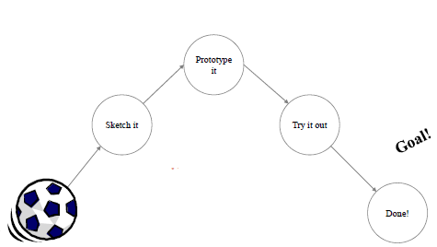
Design Process?
NO! WRONG!

Slide 21
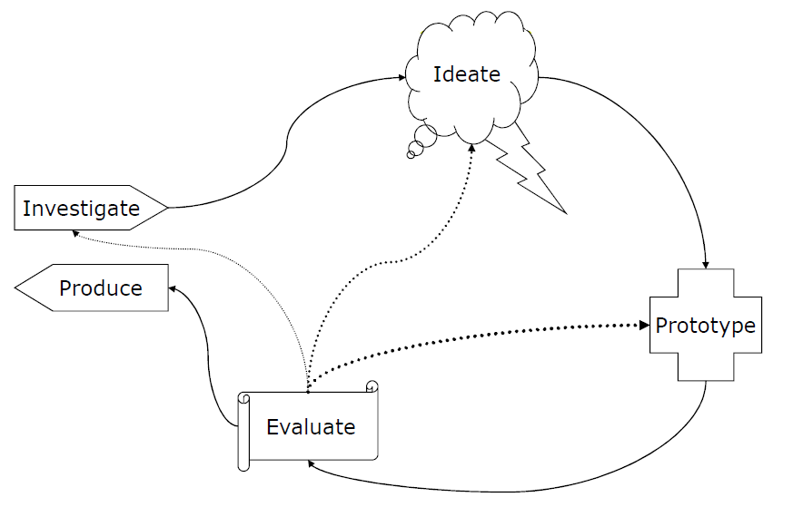
Design Requires Iteration

Slide 22
Beyond Usability
It wasn’t a focus on usability that made this a great experience. It was psychology.

Slide 23
it’s All About Experiences
product maturity continuum
Functional
ideas typically start off as functional solutions to a problem—something useful. Think of the first Motorola cell phone. sure, it was a brick, but it allowed you to make calls untethered to a fixed spot! every new technological innovation starts at a functional level.

Slide 24
it’s All About Experiences
product maturity continuum
Reliable
From there, things have to be reliable. This can be reliability of the service (five nines uptime?) as well as integrity of the data. if i purchase tickets on a travel site, the ticket prices need to be current and reliable. if i host with a site, I need to know my data is backed up and accessible at all times. This is reliability. When sites fail at reliability, especially where personal data is involved, little else matters.

Slide 25
it’s All About Experiences
product maturity continuum
Usable and Convenient
it’s not enough to allow me to simply do something—it has to eventually be less awkward to use. This is where the next two levels, usable and convenient, come into play. i make
a distinction between usability and convenience.
Both make something easier to use, but
in my experience most usability groups focus

Slide 26
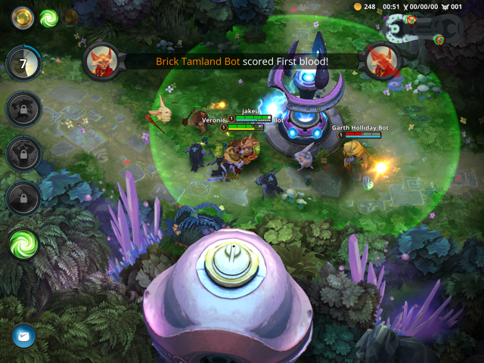
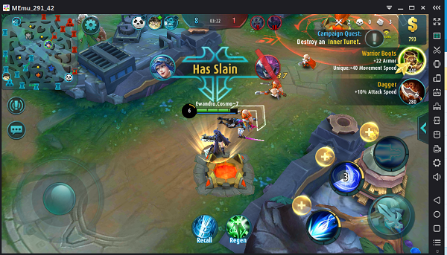
Case Study
Compare Vain Glory and Mob User Experience

Slide 27
References
Buxton, William. 2007. Sketching user experience. Elsevier
Anderson, Stephen. 2011. Seductive Interaction Design. New Riders.
Faranello, Scott. 2016. Practical UX Design. Packt Publishing

